Slide 1

Notes:
Opening Statement Hello, Jeff and I are going to talk to you today about the ISPO Working Group, which is a working group within the InnerSource commons devoted to creating shared resources for people working on InnerSource at an Enterprise level.

Slide 2
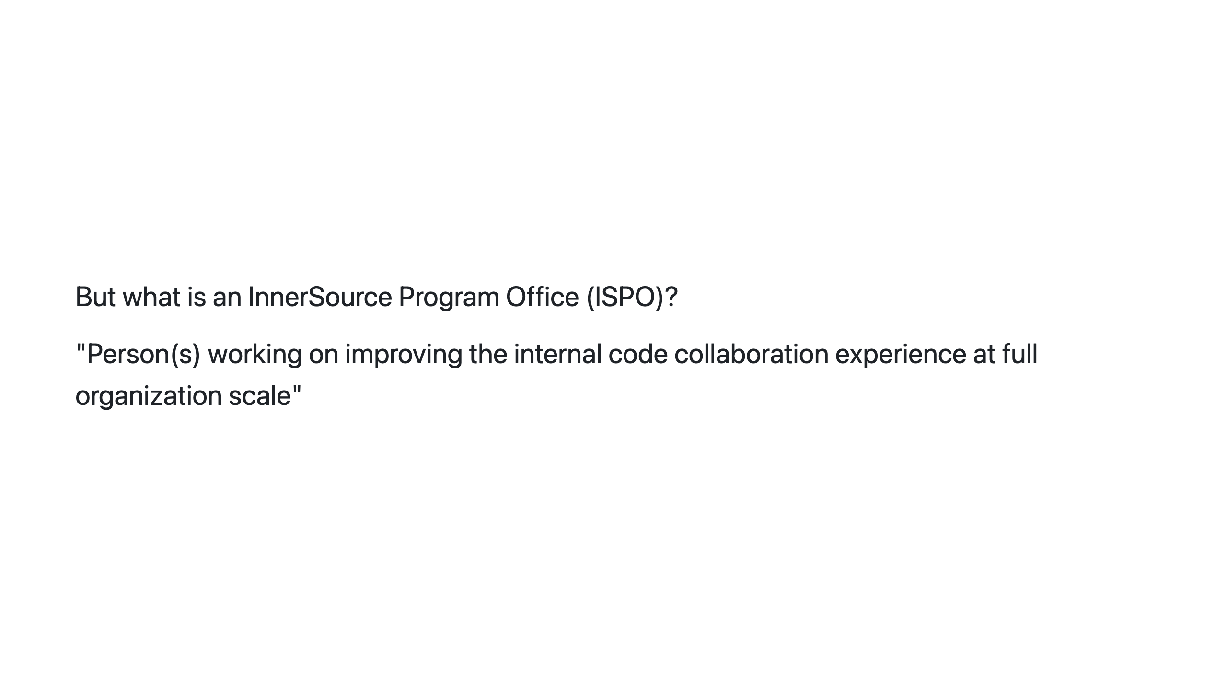
Notes:
What is an ISPO?: Key Message ISPO is an acronym. It stands for InnerSource Programs Office. We define it as "Person(s) working on improving the internal code collaboration experience at full organization scale".

Slide 3
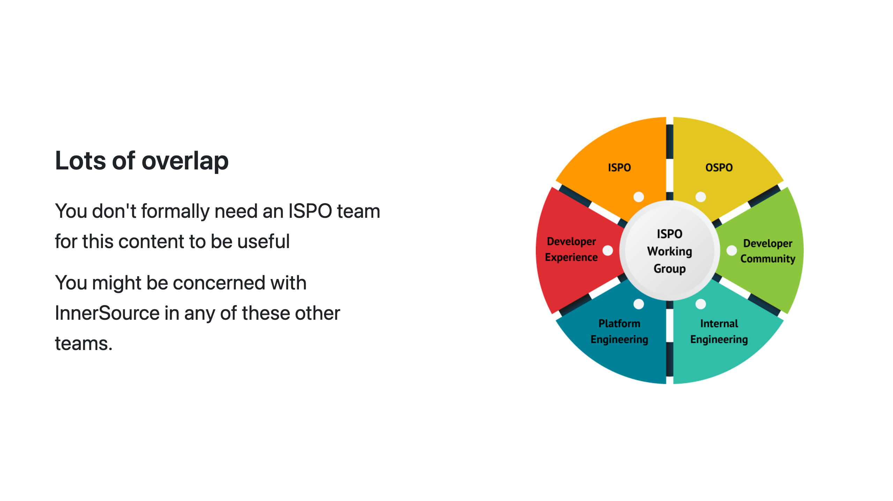
Notes:
Overlap: Key Message It is pretty rare that is there a team called the ISPO. Often the people doing InnerSource related work in a company are in a team with a large scope of responsibilities and InnerSource is just one aspect of that scope. They might be in a team called the OSPO, or open source programming office, or part of a centralized engineering team, or a platforms team, or a developer experience team. They also could be single person working under the head engineering or as part of an engineering community of practice. When we say ISPO, what we really mean is anyone on any of those teams concerned with internal code collaboration at company-scale. So if that sounds like you, then you are especially who we are trying to reach today with this presentation and working group.

Slide 4
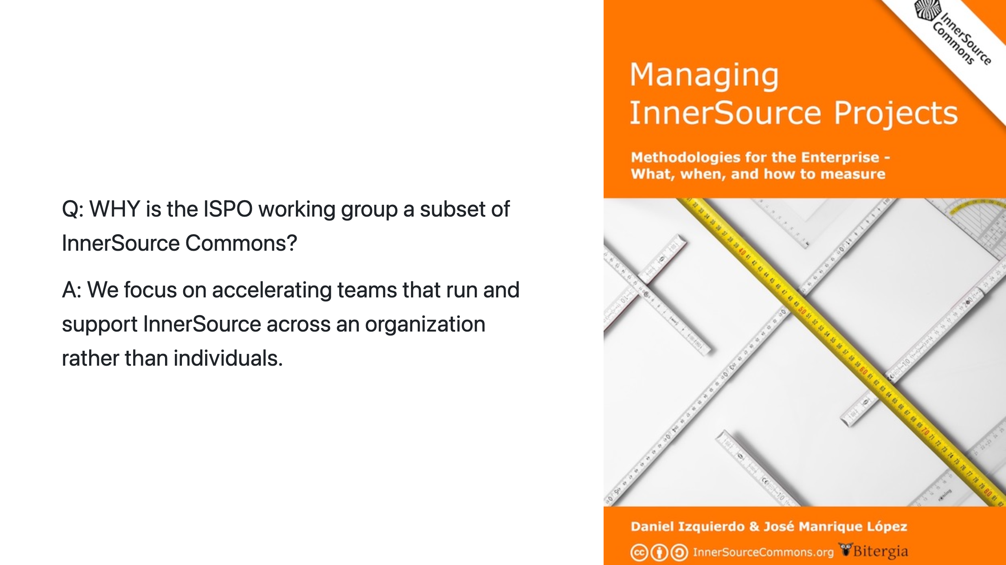
Notes:
Why ISPO?: Key Message The ISPO working group focuses on a subset of the larger InnerSource Commons scope. We focus on guidance for the teams that run and support InnerSource across an enterprise or agency rather than guidance at the project or individual level. For example, in the InnerSource Commons patterns, there is guidance for how to be a good InnerSource maintainer and guidance on how to set up your project for InnerSource success. Those are important areas, but they are outside of the scope of the working group. Instead, the working group focuses on elements specific to centralized teams driving InnerSource at company-wide scale.

Slide 5
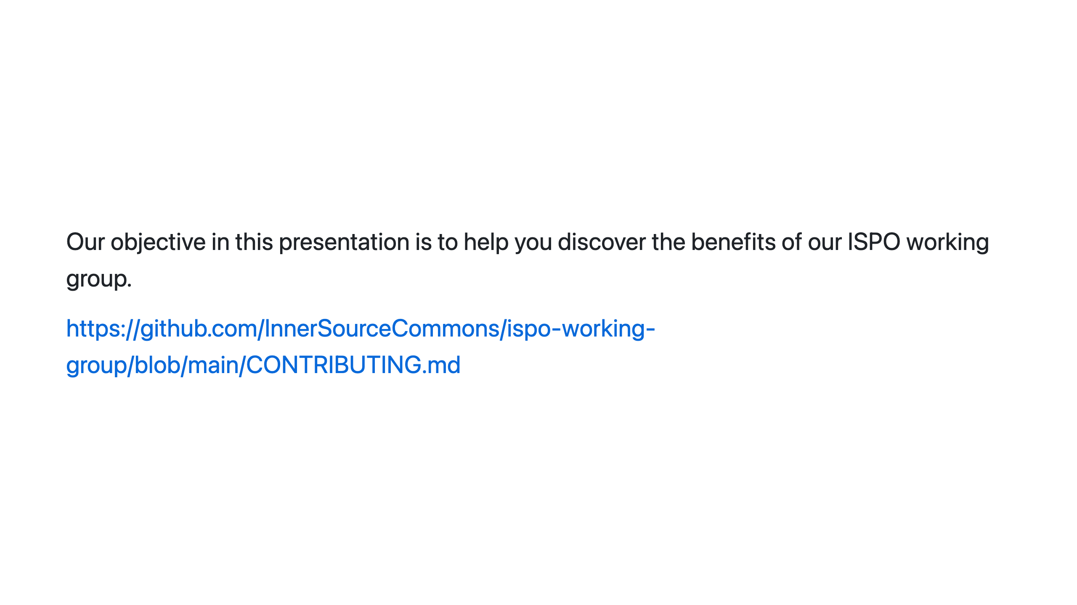
Notes:
Our objective: Key Message Our goal for this talk is to help you learn about the ISPO working group and how it might benefit you. In addition to the content in this talk, you can check out similar information in the contributing.md file of the ispo-working-group repository. We will put it in the meeting chat. If you want to look at things during the talk, that's a great place to start. https://github.com/InnerSourceCommons/ispo-working-group/blob/main/CONTRIBUTING.md

Slide 6

Notes:
Why participate?: Key Message We have structured the working group such that by participating in the working group you can increase the speed and impact of your InnerSource Program Office. The model the working group follows to do that is: - We create shared products, guidance docs, methodology descriptions, etc. based shared challenges that we have. - These get peer reviewed from other InnerSource experts, - and then the final product gets reused internally by yourself and by others. This improves the quality of work and enables us to move FASTER than if we each did the work individually.

Slide 7
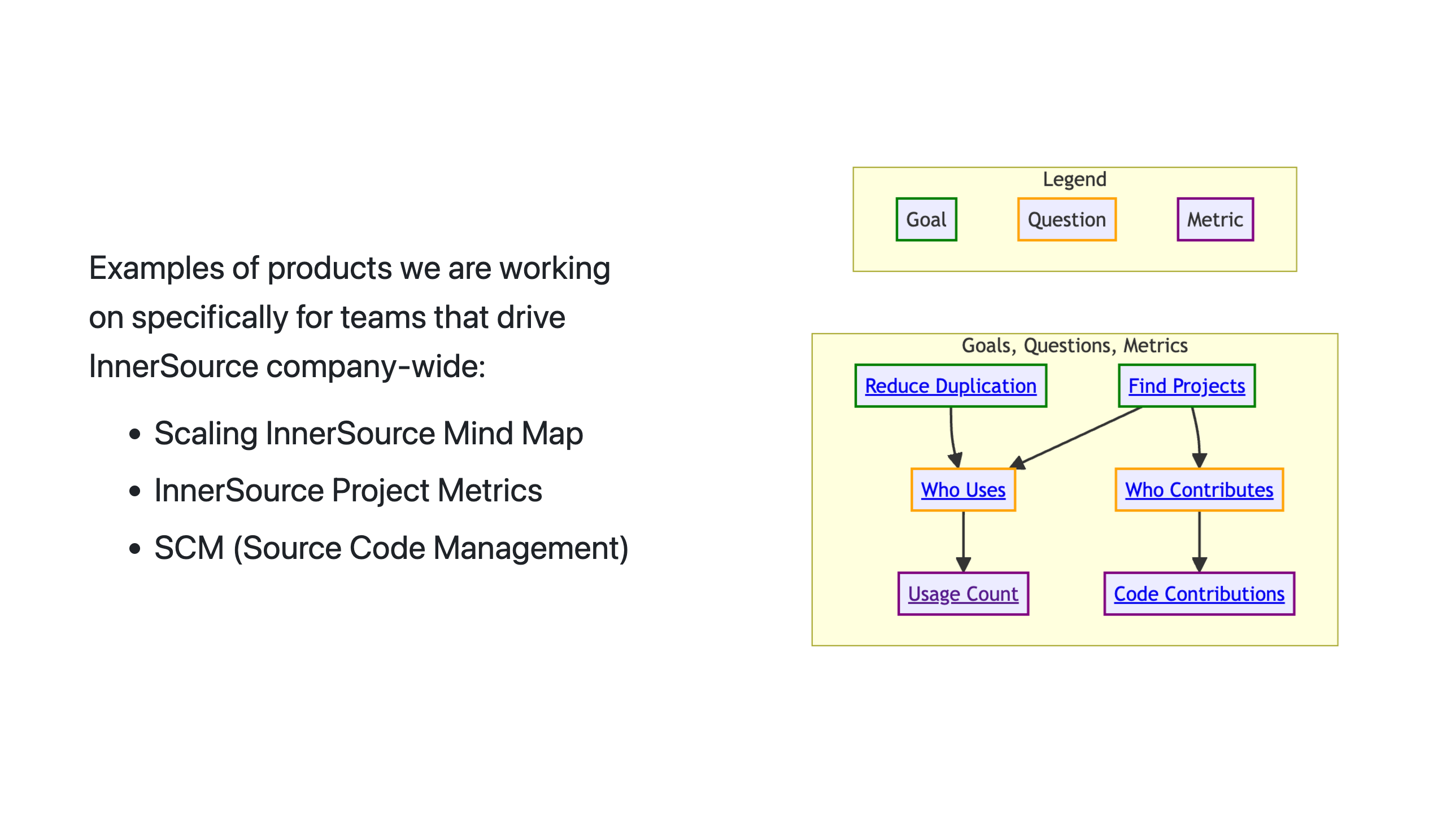
Notes:
Example products: Key Message Examples of challenges we are working right on include: * Scaling InnerSource Mind Map * InnerSource Metrics * SCM (Source Code Management) These are all challenges where many people in the working group have tried different things, have different lessons to share, and want to learn from the experience of others who have tried other approaches at their own companies.

Slide 8
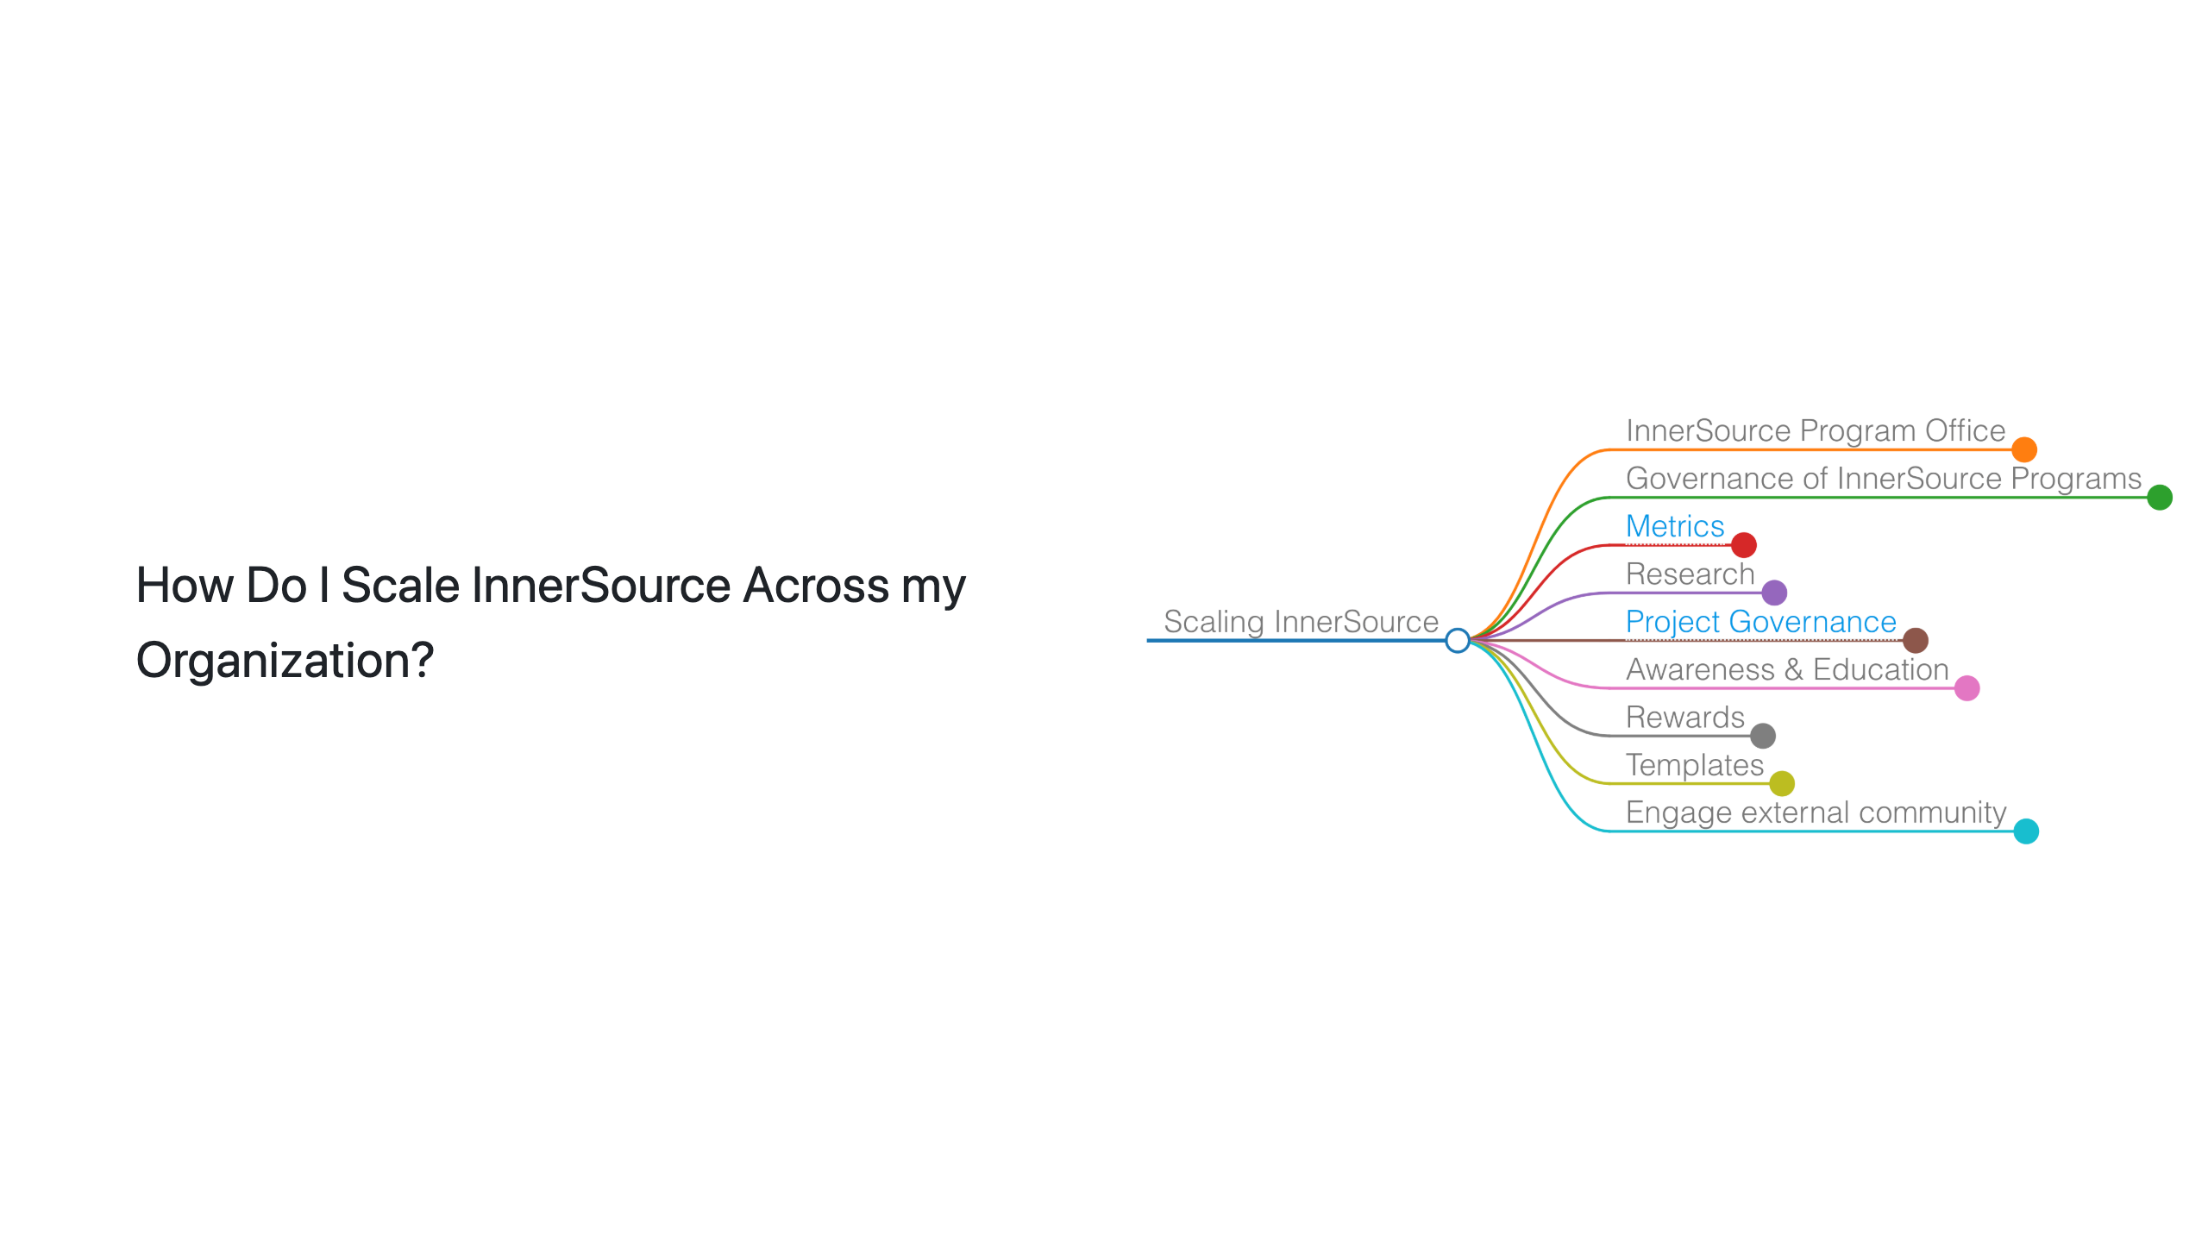
Notes:
Scaling InnerSource Mind Map: Key Message A common challenge for new ISPOs is how to scale InnerSource across the organization. To help with this, we are creating a mind map that will help you navigate the challenges and opportunities of scaling InnerSource.

Slide 9
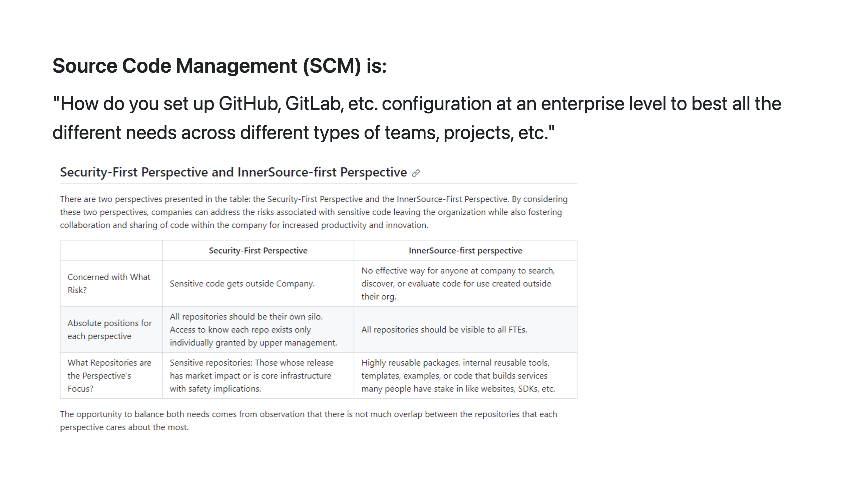
Notes:
Source Code Management (SCM): Key Message One area I have contributed to is in defining guidance for source code management or SCM. SCM refers to how you set up or configure a version control platform like GitHub, GitLab, Bit Bucket, etc. There are lots of decisions to be made in how these platforms are configured and different needs have to be balanced. Shown on the slide is a screenshot of one part of our in-progress guidance document. It discusses how to balance needs of security and collaboration. These needs can sometimes conflict, resulting in disagreements. And in a worst case scenario, a single security event can result in a sudden lock down across the enterprise that kills off collaboration. By making guide from different perspectives and experiences, we are able to provide an improved framework for how to make good configuration choices in version control platforms that balance the various needs, like security vs. collaboration.

Slide 10
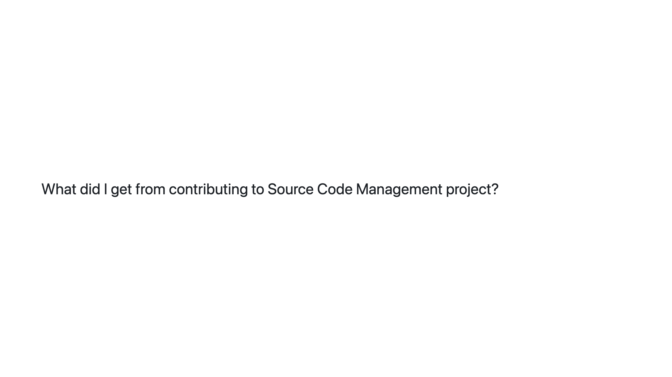
Notes:
What did I get?: Key Message The source code management challenge is one area where I have personally participated in creating ISPO working group content. There are several reasons why I took part in this challenge area: First, to get more value from hard won lessons by sharing them with others. Second, I want my perspective in external resources, so I can later refer to those external resources rather than just sharing an email with my personal opinion. Sharing a link to an inner source commons product is more persuasive. Third, I wanted to confirm my opinion is aligned with the experiences of others who have struggled through this at their company. Fourth, sharing grows my network and provides opportunities to sense check other ideas I might have in the future.

Slide 11
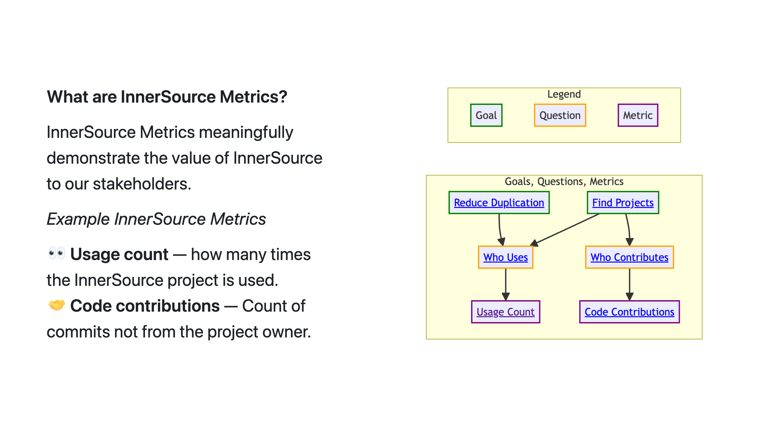
Notes:
Metrics: Key Message Thanks Justin, as previously shown we built an InnerSource metrics graph. As ISPO leaders, we’re often asked to articulate the value of InnerSource to our stakeholders. Using the InnerSource Metrics graph, we can achieve this goal. For example, we may want to find valuable projects by identifying who contributes to them. The code contributions metric helps us with this goal and answers our question. By navigating and contributing to the goals, questions, metrics graph we can demonstrate the value of our InnerSource projects.

Slide 12

Notes:
Benefit?: Key Message Through my involvement in the metrics project, I didn't just gather data; I built a network. I connected with professionals who, like me, were navigating the world of InnerSource metrics. As I contributed to this project, my professional network grew. As a result of these efforts, I'm connected to great, like-minded professionals ready to help expand the value of the InnerSource Commons. Looking ahead, this experience isn't a one-time benefit. When my company expands InnerSource project measurement, we'll be steps ahead, armed with a deep understanding of diverse approaches.

Slide 13
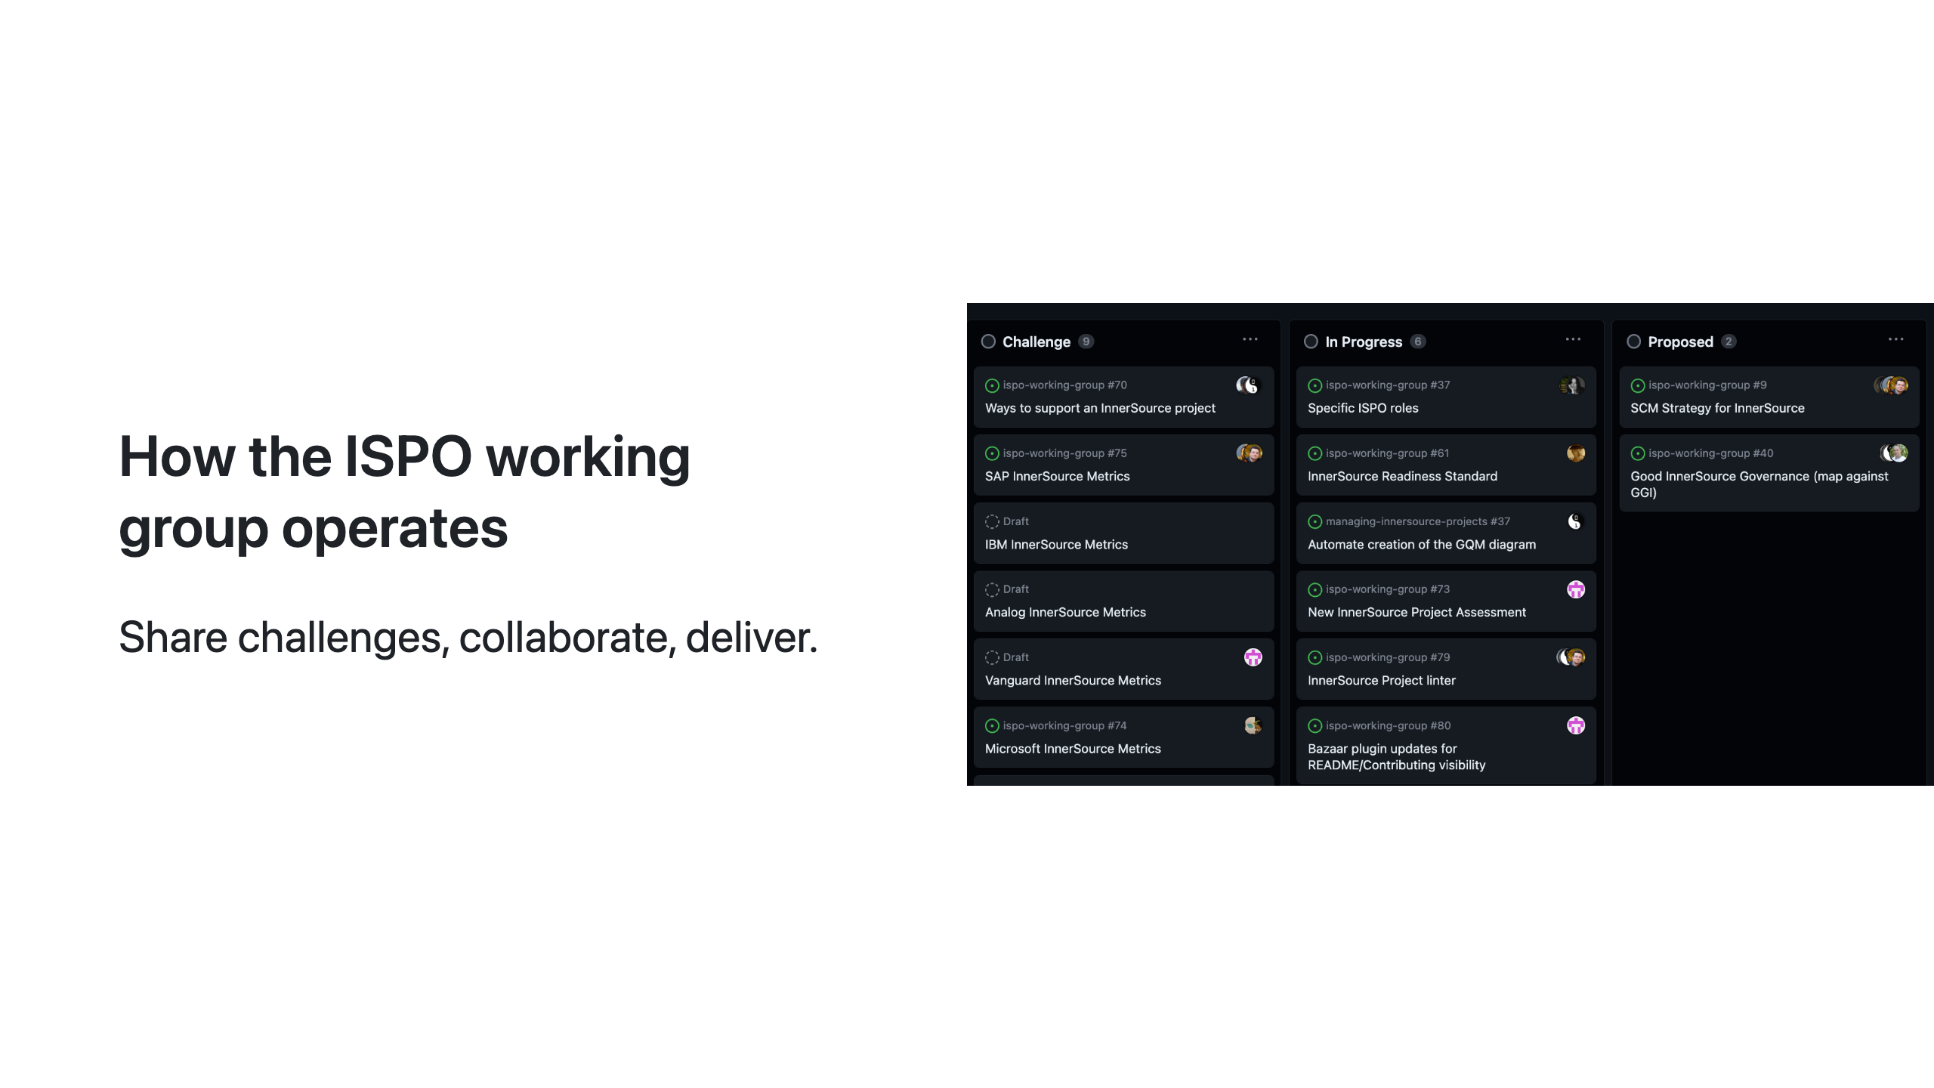
Notes:
How do we operate?: Key Message So, how do we operate? Through conversations, ideation, and sharing our challenges, we work together to build peer-reviewed content fit for your organizations. We value progress over perfection, and encourage you to share your challenges and solutions with us.

Slide 14
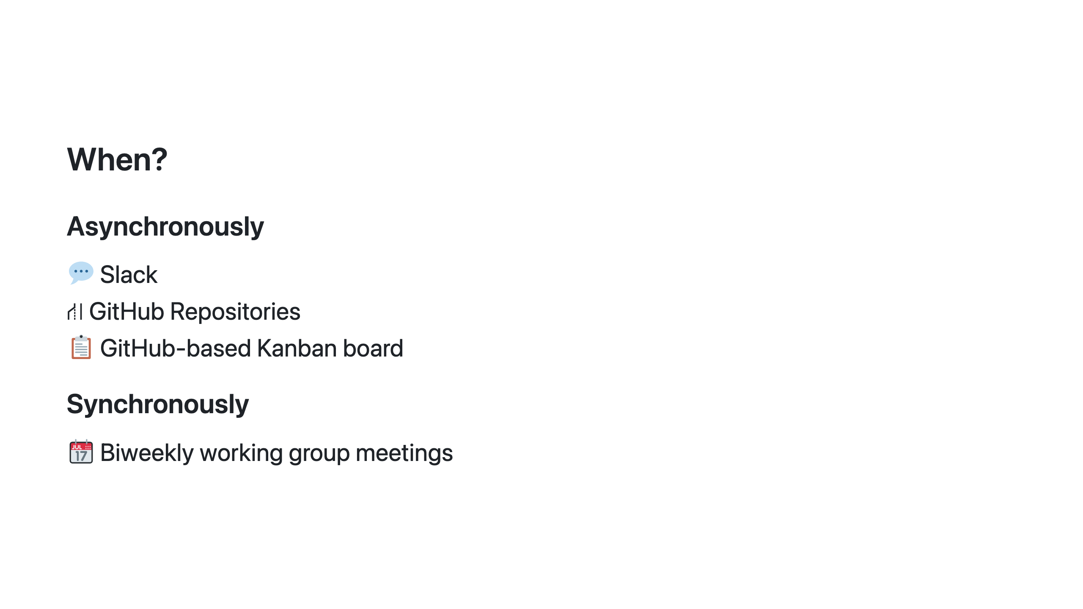
Notes:
When do we collaborate?: Key Message When do we collaborate? Biweekly meetings, slack, GitHub, and mobbing sessions.

Slide 15
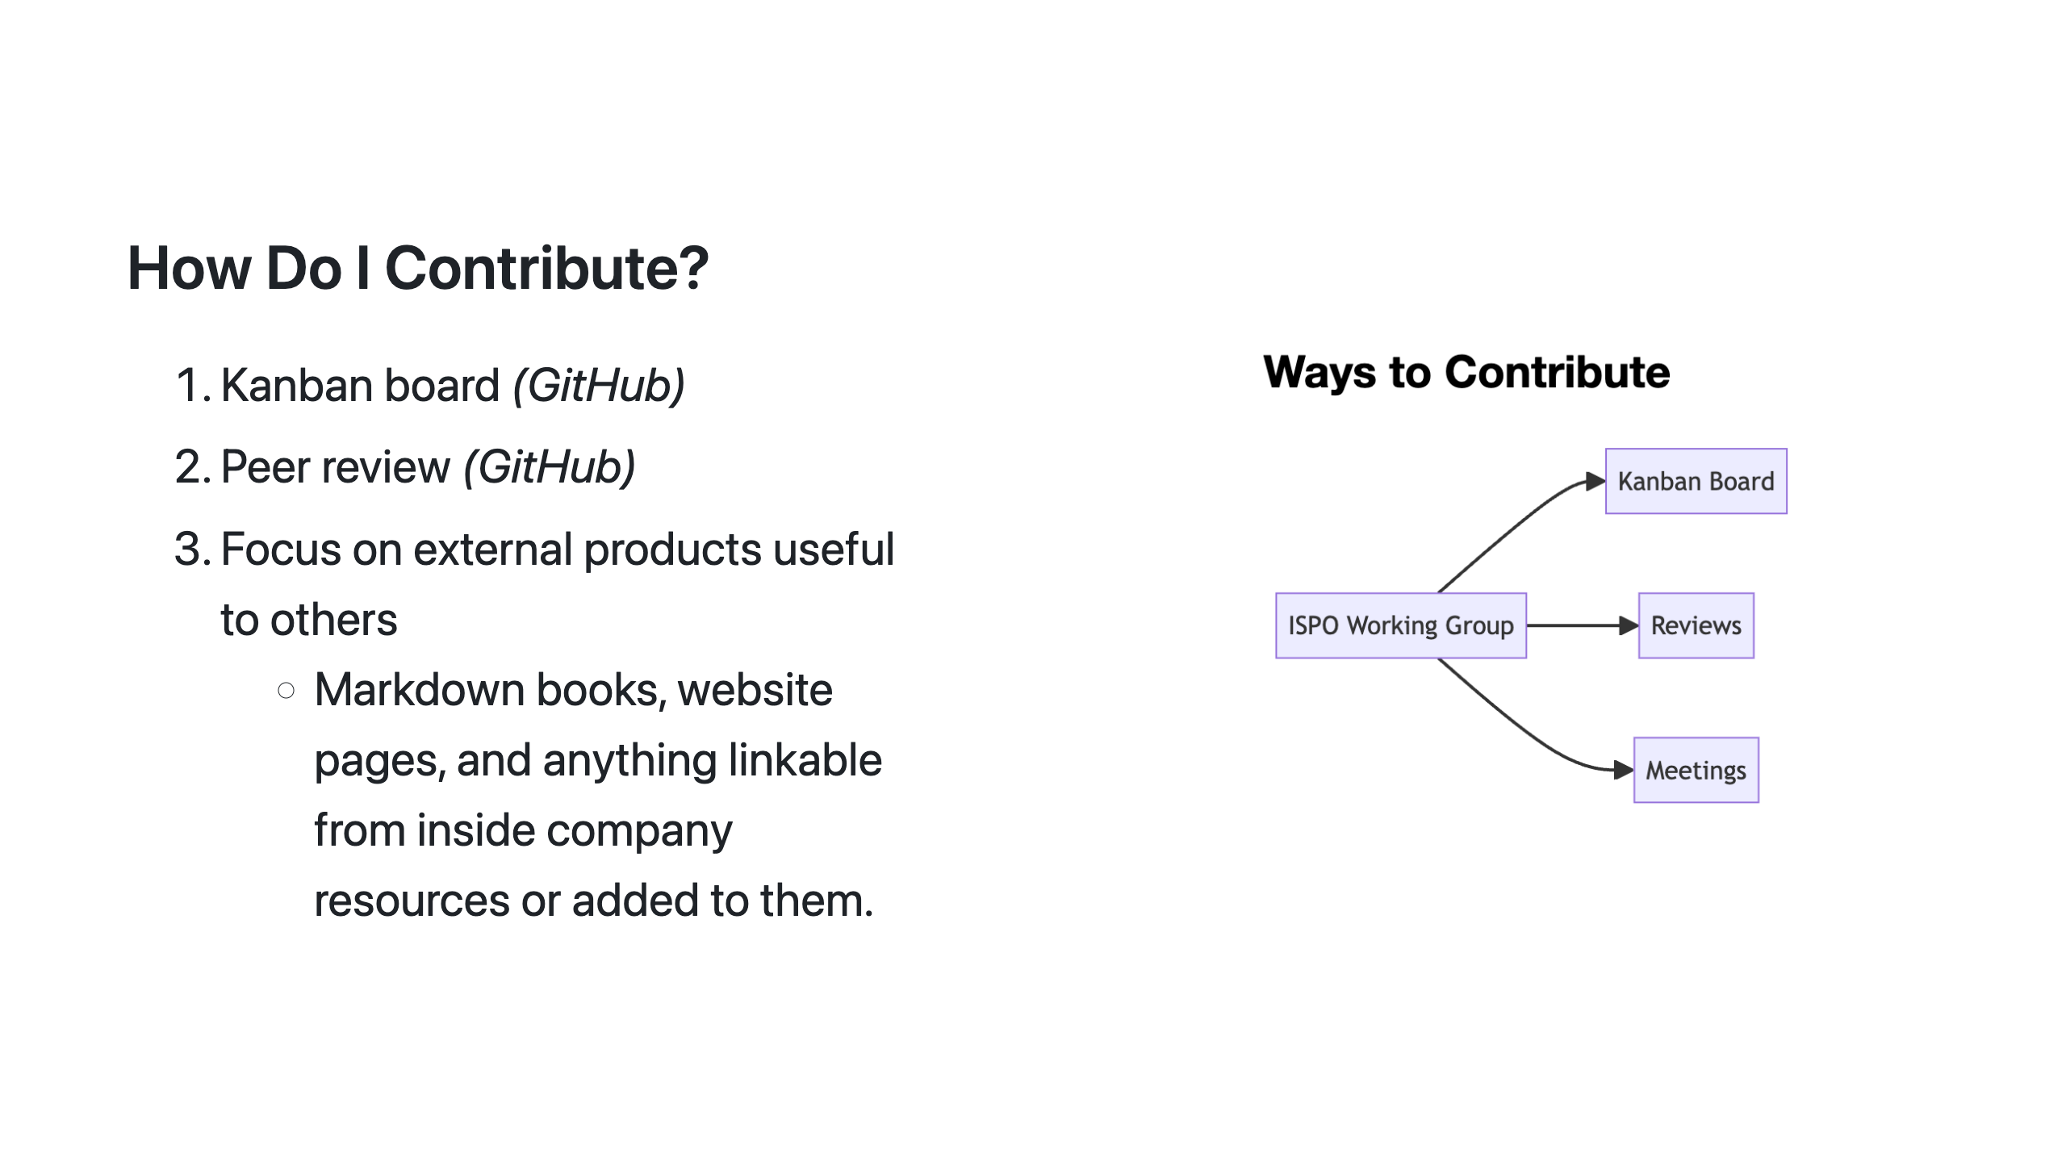
Notes:
How to contribute?: Key Message All work within our group undergoes a peer review as it progresses through the Kanban board. We align our work with the goals and objectives of our companies while also contributing to the InnerSource Commons. We contribute to the Managing InnerSource Projects Gitbook, InnerSource Patterns, and other projects relevant to leaders of ISPOs, OSPOs, and the like.

Slide 16
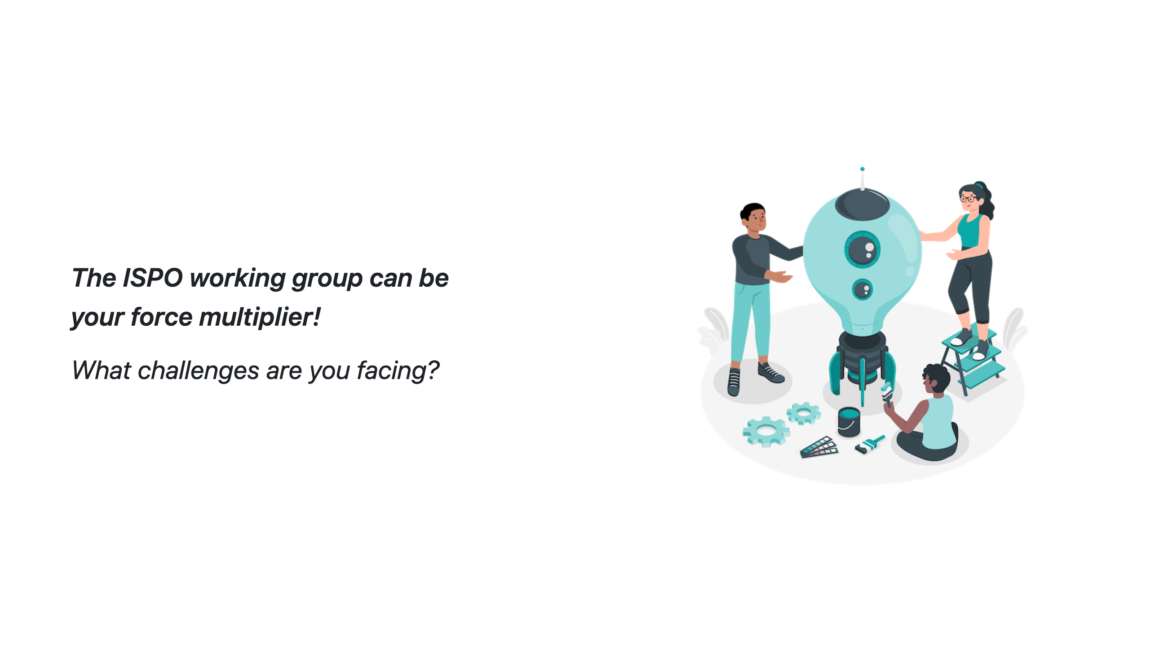
Notes:
Challenges?: Closing Point of View We invite you to align your company backlog with our working group. We can produce content at a lower cost and get feedback from deeply experienced people. Is there a challenge you’ve facing today?

Slide 17
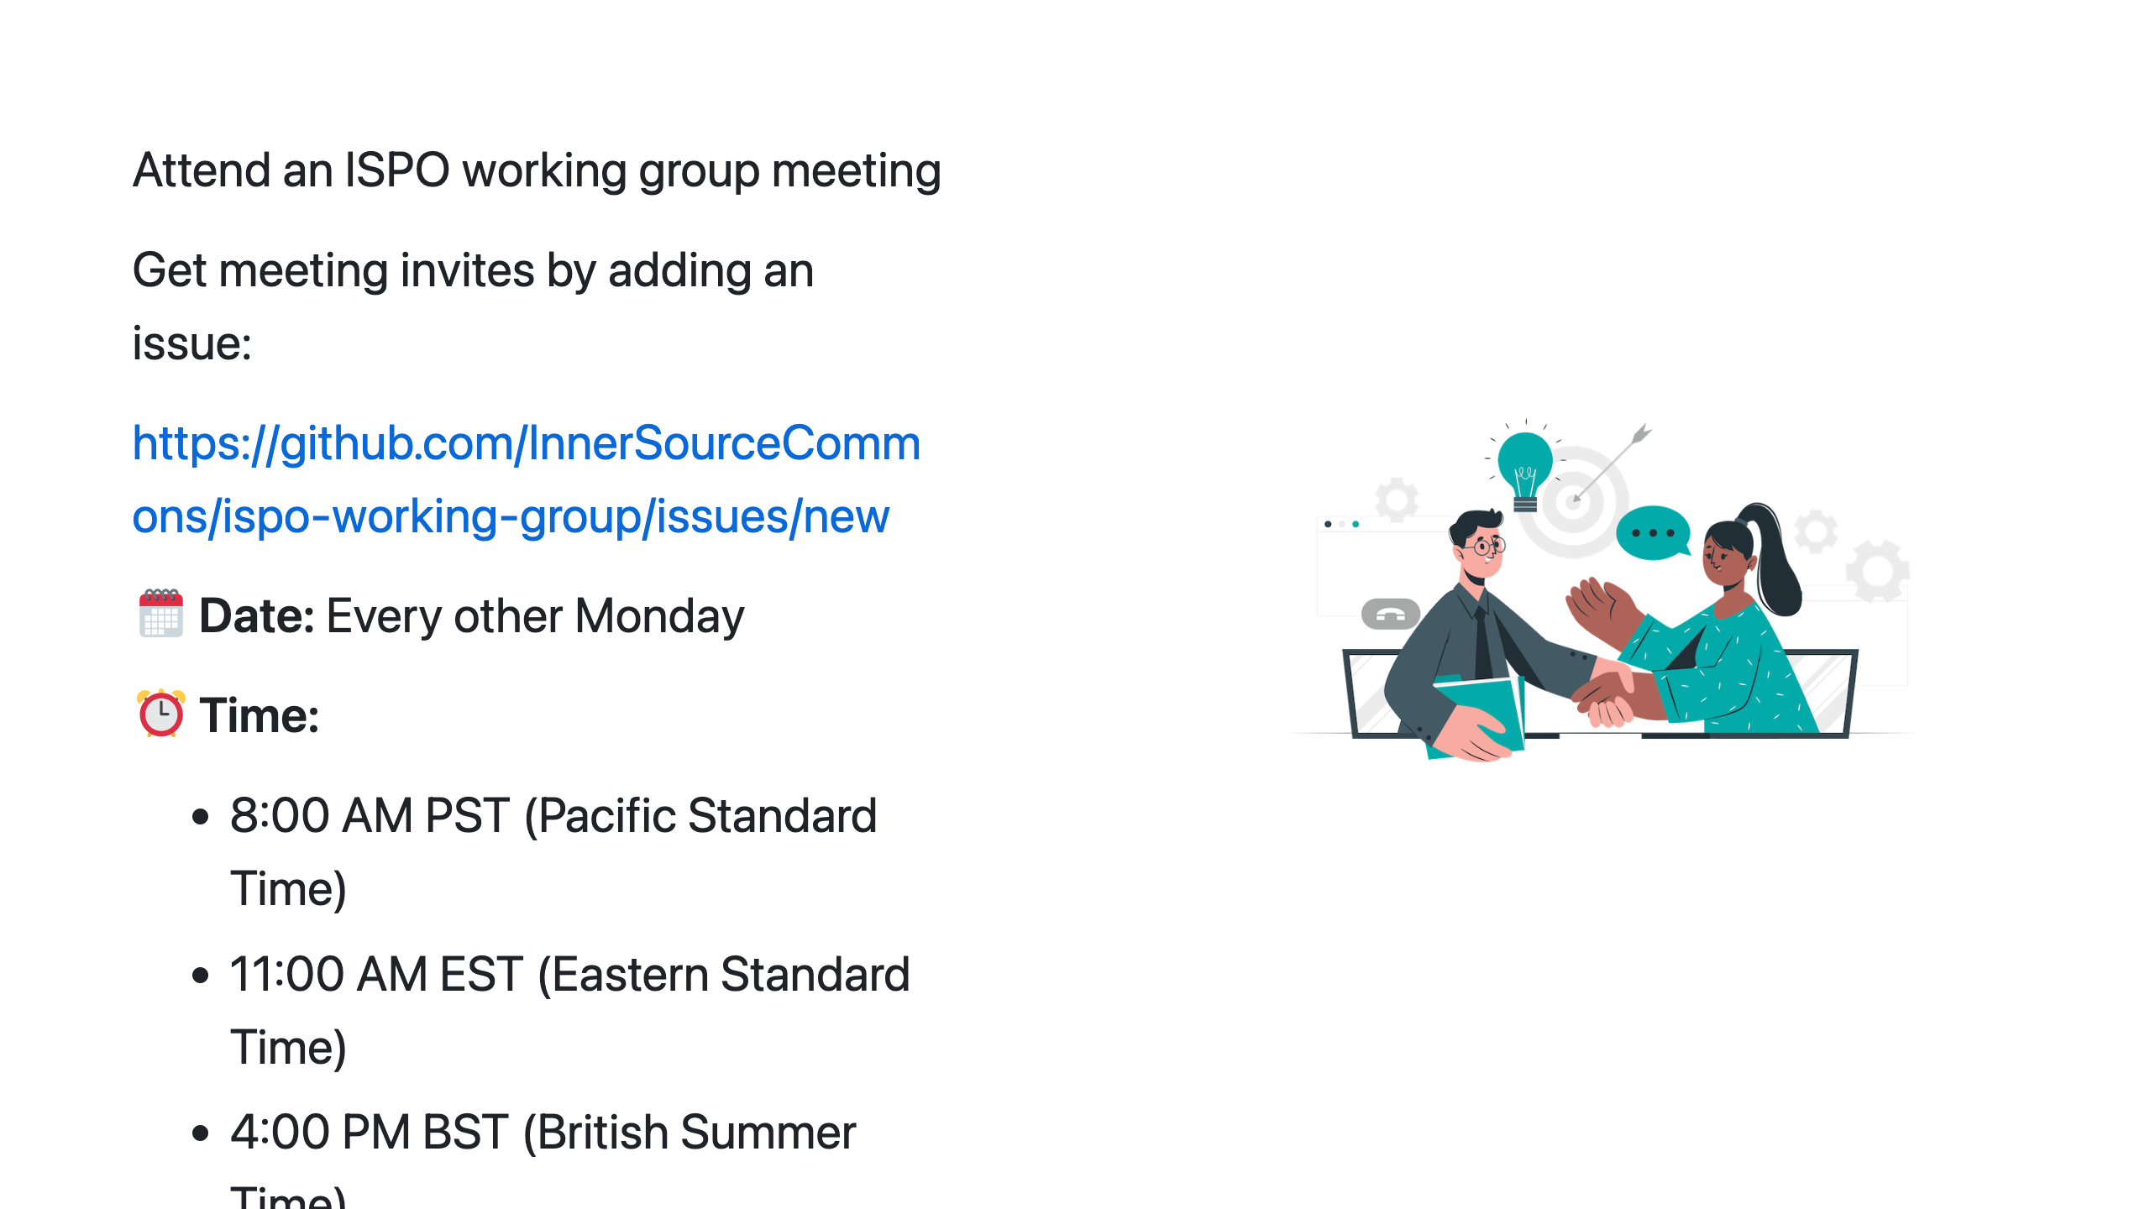
Notes:
How do I attend?: Specific Action Attend the ISPO working group meeting on November 2nd.

Slide 18
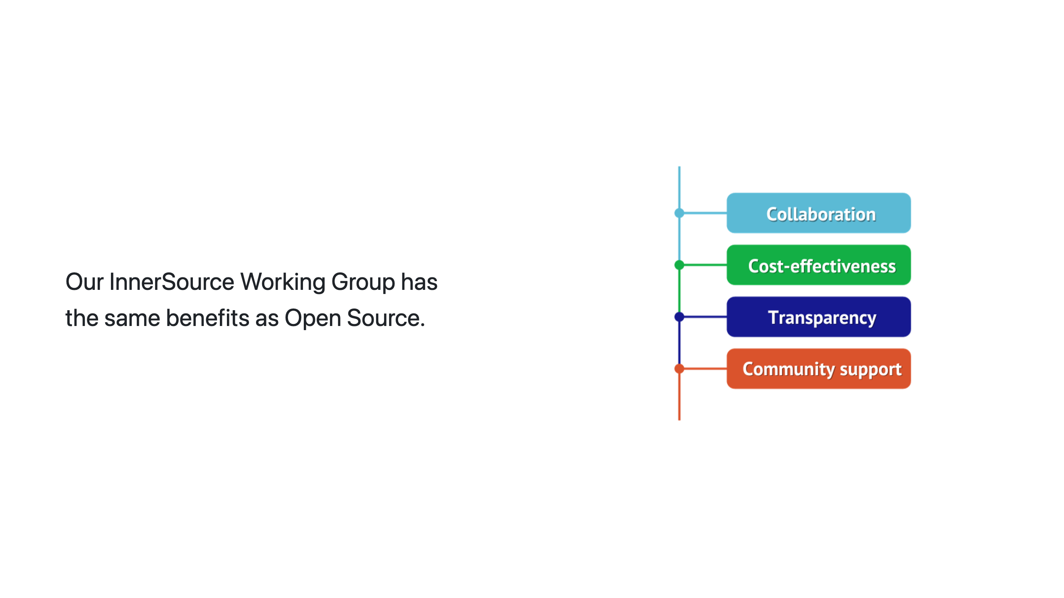
Notes:
InnerSource like Open Source: Benefits of Action We already know the benefits of Open Source. Our InnerSource Working Group provides the same benefits. Collaboration opportunities, code reuse, knowedge sharing through community, and more.

Slide 19
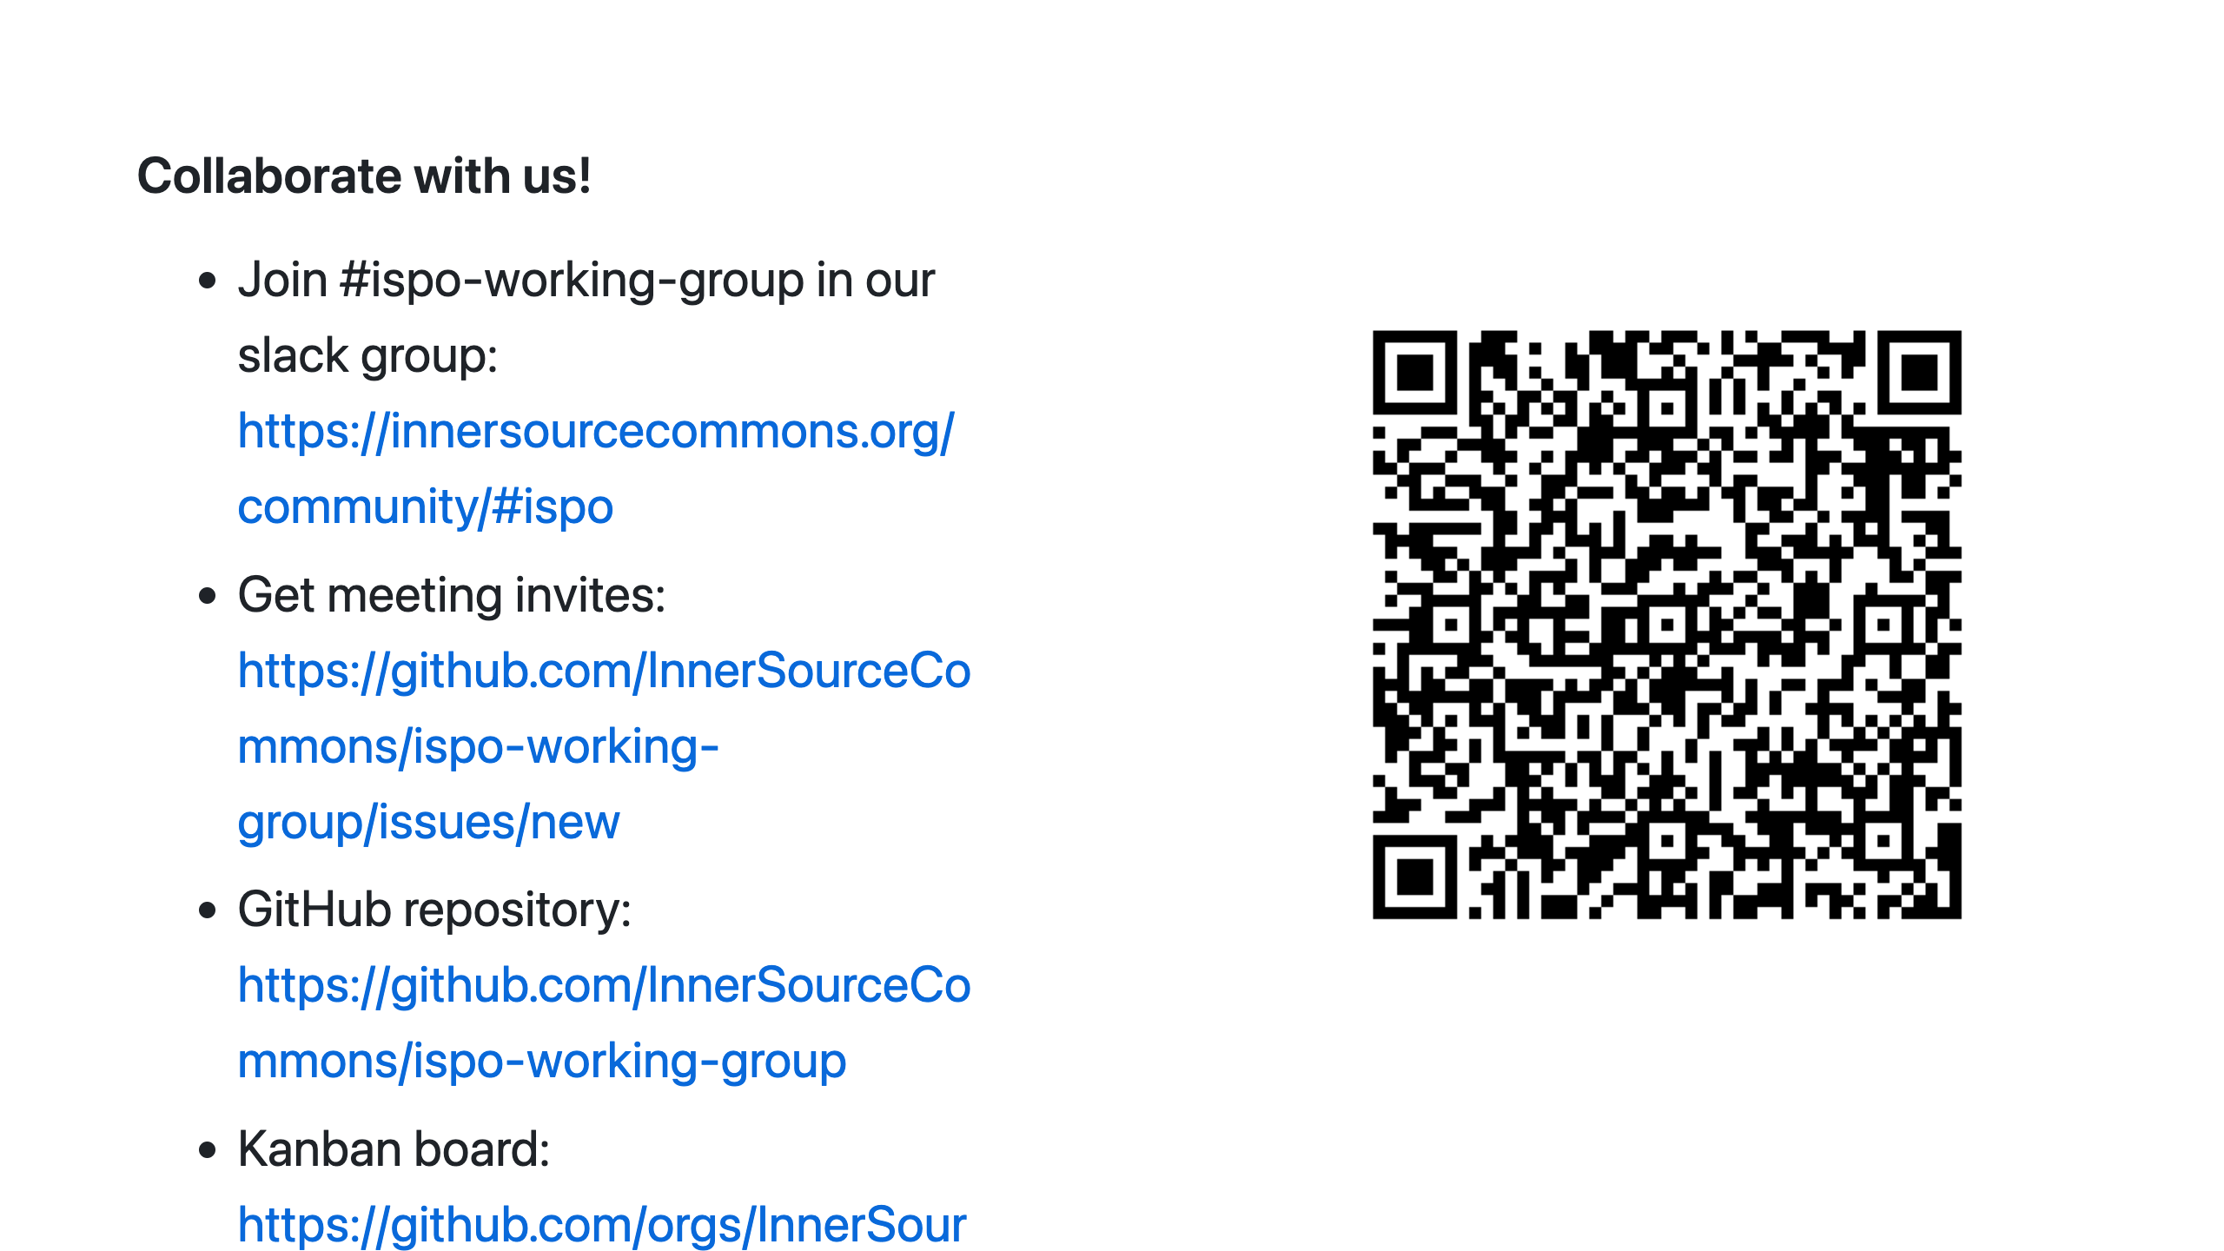
Notes:
Join our group: Closing Statement The InnerSource Program Office (ISPO) Working Group is an opportunity for those involved in enterprise-level software development. Whether you're a member of an ISPO, OSPO, Platform Engineering Team, or other centralized groups, you'll find benefits . Our group allows you to contribute and benefit from a wealth of shared experience, enhancing your organization's InnerSource capabilities. As we wrap up with questions, join us at the InnerSource Program Office Working Group by navigating to the first link or scanning the QR code to join our Slack group. Thank You

